Slide 1
CHAPTER 8
More Examples…

Slide 2
CHAPTER 8
Example 2
A survey of teenagers and parents in Canada conducted by the polling organization Ipsos (“Untangling the Web: The Facts About Kids and the Internet,” January 25, 2006) included questions about Internet use. It was reported that for a random sample of 676 parents of
Canadian teens, the mean number of hours parents thought their teens spent online was 6.5 and the
sample standard deviation was 8.6.
Do the sample data provide convincing evidence that the mean number of hours that parents think their teens spend online is less than 10 hours per week? Use α=.05.

Slide 3
CHAPTER 8
i) Hypotheses.

Slide 4
CHAPTER 8
ii) Test Statistic.

Slide 5
CHAPTER 8
iii) Level of significance.
iv) Rejection Region.
v) Calculation of test statistic.

Slide 6
CHAPTER 8
vi) Decision and Conclusion

Slide 7
CHAPTER 8
Example 3
Environmental Science & Technology (October 1993) reported on a study of contaminated soil in the Netherlands. Seventy-two 400-gram soil specimens were sampled, dried, and analyzed for the contaminant cyanide. The cyanide concentration [in milligrams per kilogram (mg/kg) of soil] of each soil specimen was determined by an infrared microscopic method. The sample resulted in a mean cyanide level of =84 mg/kg and a standard deviation of s = 80 mg/kg.
Test the hypothesis that the true mean cyanide level in soil in the Netherlands exceeds 100 mg/kg. Use
α = .10.

Slide 8
CHAPTER 8
i) Hypotheses.

Slide 9
CHAPTER 8
ii) Test Statistic.

Slide 10
CHAPTER 8
iii) Level of significance.
iv) Rejection Region.
v) Calculation of test statistic.

Slide 11
CHAPTER 8
vi) Decision and Conclusion.

Slide 12
CHAPTER 8
Chapter 8: Inferences Based on a Single
Sample: Tests of Hypotheses
8.1 The Elements of a Test of Hypothesis
8.2 Formulating Hypotheses and Setting Up the Rejection Region
8.3 Test of Hypotheses about a Population Mean: Normal (z) Statistic
8.4: Observed Significance Levels: p-Values

Slide 13
CHAPTER 8
Definition: The p-Value
The P value(Probability value) or calculated probability is the estimated probability of rejecting the null hypothesis (H₀) of a study question when that null hypothesis is true.
or
P-value may be considered the probability of finding the observed, or more extreme, value of test statistic when the null hypothesis is true.
NOTE: Instead of rejection region in step (iv) of hypothesis testing, we now calculate p-value and make the decision based on p-value.

Slide 14
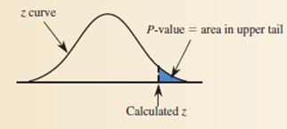
CHAPTER 8
Determination of p-value when the test statistic is z (normal):
Upper-tailed test: H_{a} : μ > μ₀ (hypothesized value)
= P (z > z_{cal})
= z_{cal}

Slide 15
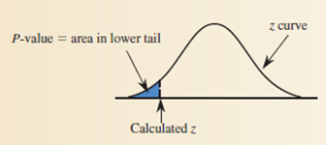
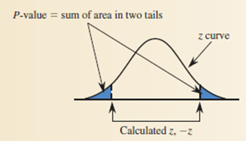
CHAPTER 8
Lower-tailed test: H_{a} : μ < μ₀ (hypothesized value)
= P(z < z_{cal})
Two-tailed test: H_{a} : μ ≠ μ₀ (hypothesized value)
= P(z < - z_{cal} or z > z_{cal}) = 2 ⋅ P(z > z_{cal} )
= 2 ⋅ P(z < - z_{cal} )

Slide 16
CHAPTER 8
Decision rules based on the p-value
If the p-value < α, we reject H₀
If the p-value ≥ α, we do not reject H₀

Slide 17
CHAPTER 8
RECALL: Example 3
Environmental Science & Technology (October 1993) reported on a study of contaminated soil in the Netherlands. Seventy-two 400-gram soil specimens were sampled, dried, and analyzed for the contaminant cyanide. The cyanide concentration [in milligrams per kilogram (mg/kg) of soil] of each soil specimen was determined by an infrared microscopic method. The sample resulted in a mean cyanide level of =84 mg/kg and a standard deviation of s = 80 mg/kg.
Test the hypothesis that the true mean cyanide level in soil in the Netherlands exceeds 100 mg/kg. Use
α = .10.

Slide 18
CHAPTER 8
i) Hypotheses.
Let μ be the true mean cyanide level in soil in The
Netherlands.
H_{o}: μ = 100 ; the mean cyanide level in soil in The
Netherlands is equal to 100.
H_{a}: μ > 100 ; the mean cyanide level in soil in The
Netherlands is greater than100.

Slide 19
CHAPTER 8
ii) Test Statistic.
We will perform a large sample z-test for the mean cyanide level in soil in The Netherlands.
Conditions:
Assume that Seventy-two 400-gram soil specimens were
sampled randomly.
The sample size n=72 is large.
Verification of these assumptions makes it reasonable to assume that the sampling distribution of the sample mean cyanide level in soil in The Netherlands will be approximately normal.

Slide 20

CHAPTER 8
iii) Level of significance.
α = 0.10
iv) Calculation of test statistic.
We are given:

Slide 21
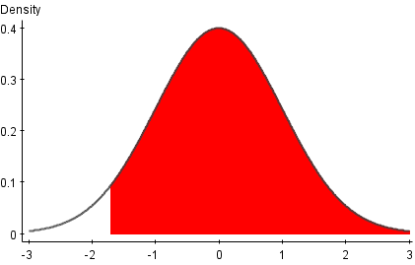
CHAPTER 8
v) p-value.
p-value = area of z-curve to the right of -1.70
= .5 + .4554 =.9554
OR
p-value = P (z > -1.70 ) = .5 + .4554 =.9554
p-value
z_{cal}= -1.70

Slide 22
If a hypothesis test using α=.05 were conducted, for which of the
following p-values would the null hypothesis be rejected?
(a).06
(b).01
(c).251
(d).042
For testing H₀: µ=100 against H₁:µ≠100, the sample data yielded
the test statistic as z=2.06, find the p-value for the test.
According to a theory in psychology, young female adults show
more empathy towards other than do males. A research journal tested
This theory by examining the attitudes of a sample of 34 female
College students. For the statement on emotional empathy the sample mean response was 3.28. Assume that population standard deviation for female is .5. Suppose it is known that male college students have an average emotional empathy score of µ=3.
Specify the null and alternative hypothesis for testing whether female students are more vulnerable.
Compute test statistic.
Find p-value.
At α=.01, what is your conclusion from the p-value?

